Slide 1

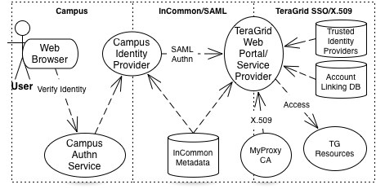
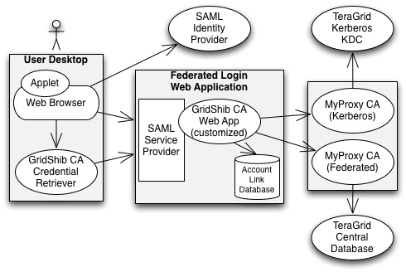
Federated Logon to TeraGrid
https://go.teragrid.org
Federated logon to TeraGrid relies on translation of credentials between the campus domain, InCommon, and the TeraGrid single sign-on system.
The TeraGrid federated logon system provides certificates, issued by a MyProxy CA, for web and desktop applications. The web application binds campus identities to TeraGrid identities via an account-link database.
First the researcher visits the home page and selects his or her campus from the identity provider list. In case the researcher’s campus is not available, he or she can login via ProtectNetwork.
Next the researcher logs in at the campus login page (ex. University of Illinois).
Then, the researcher logs in to TeraGrid to bind the campus and TeraGrid identities. This is a one-time-only operation.
Choosing to download a credential to the desktop launches a simple Java Web Start application (from the GridShib project) to generate a keypair, issue a certificate request to the server, receive a signed certificate in return, and store them to the desktop.
The GSI-SSHTerm Applet supports remote login via the browser, including X11 forwarding.
The researcher can view and delete identity bindings via the web interface.
After login, the site presents the researcher with options to download a certificate to the desktop or launch Java applets for remote login and file transfer using the certificate for authentication.
This material is based upon work supported by the National Science Foundation under grant number 0503697. Any opinions, findings, and conclusions or recommendations expressed in this material are those of the author(s) and do not necessarily reflect the views of the National Science Foundation.
Notes:
Federated Logon to TeraGrid
We present a new federated login capability for the TeraGrid, currently the world’s largest and most comprehensive distributed cyberinfrastructure for open scientific research. Federated login enables TeraGrid users to authenticate using their home organization credentials for secure access to TeraGrid high performance computers, data resources, and high-end experimental facilities. Our novel system design links TeraGrid identities with campus identities and bridges from SAML to PKI credentials to meet the requirements of the TeraGrid environment.

